Slide 1
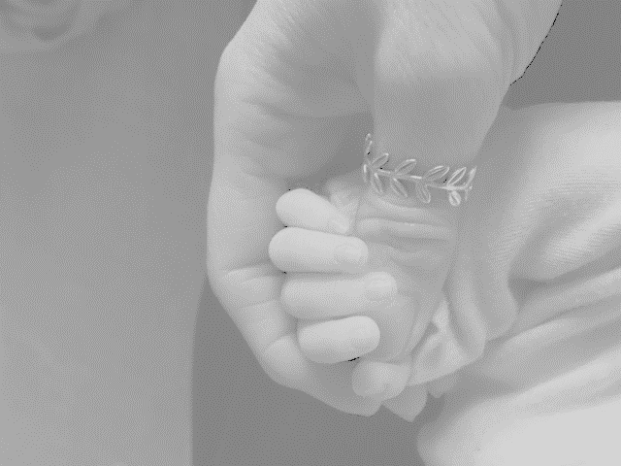
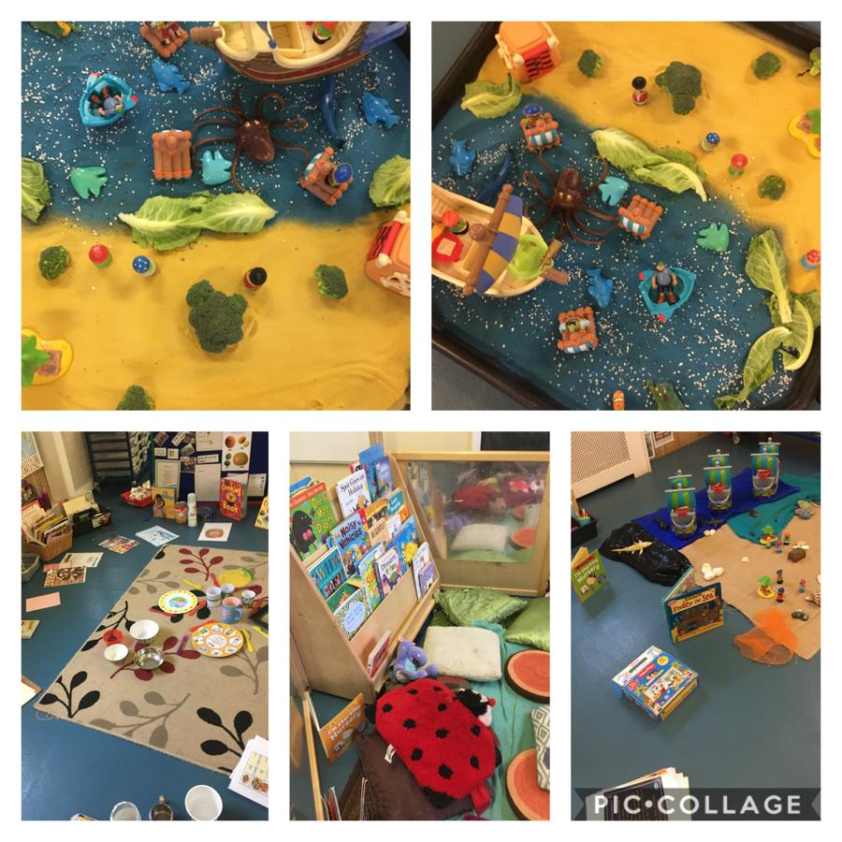
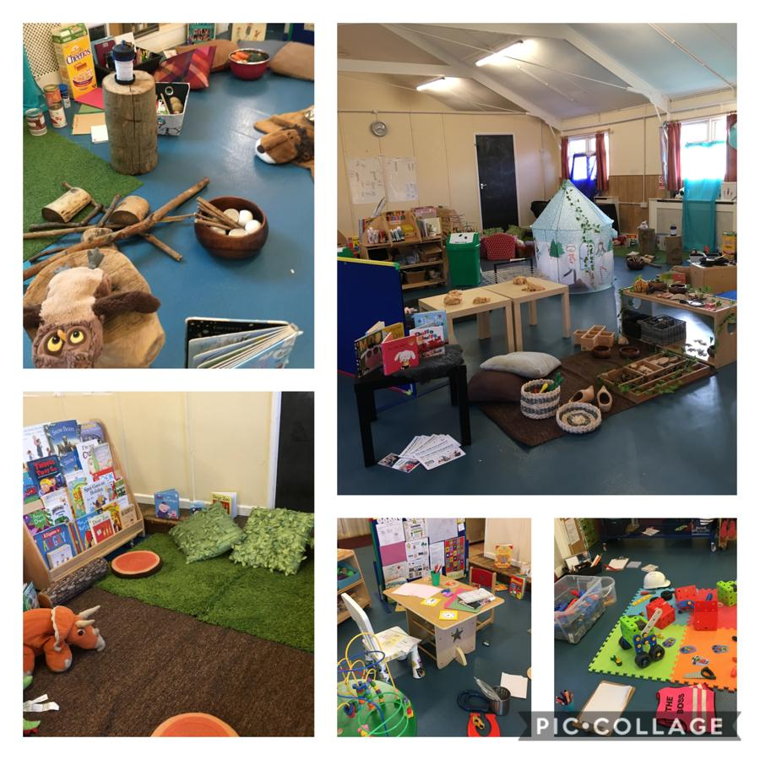
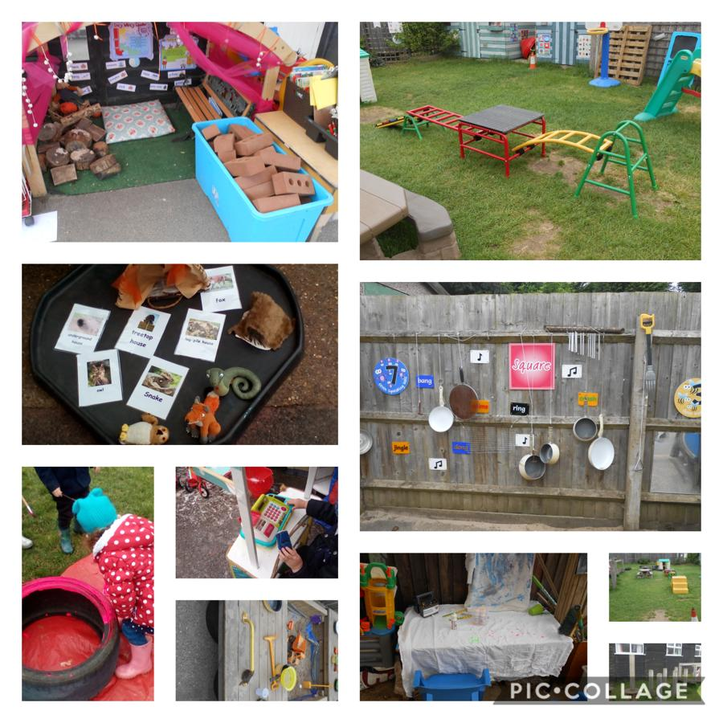
Every day a different day
Every day new
* Spaces available for September 2022 *
We accept children from 24 months
2, 3 and 4 year funding is available
Morning, afternoon and full day sessions 5 days a week
8.30 – 11.30 am, 12.00 – 3.00 pm
Or all day 8.30 – 3.00 pm
Please email; office@stmichaelspreschool.org.uk
Phone; 01733 686158 or 07468242720
Website; www.stmichaelspreschool.org.uk
St Michael’s Pre-school
Mace Road
Stanground
PE2 8RQ
Teaching is of a consistently high quality
Holding your child’s hand whilst building the foundations for life ………

